Slide 1
E-Commerce Product Delivery Production
Presented By: Shivam Kilanjar

Slide 2
Agenda
This project aims to enhance the understanding of products delivery patterns and
customer behaviour for an international e-commerce company specializing in
electronic products.
To Develop robust machine learning models to accurately predict delivery timeliness.
In short by using Machine Learning models the project’s objective is to determine whether the products will reach customers on time.
Through the prediction of delivery by these models it would also enable the company to improve customer satisfaction and optimize logistics.
Understand the key factors influencing delivery prediction.

Slide 3
DATA PREPROCESSING
Data Loading: Loaded the dataset from excel file.
Data Cleaning(Handling Mission values): Dropped the rows having missing values.
Conversion of Categorical Values: Converted all the categorical values into numerical values by using a method called Mapping.
Standard Scale: Applied a method called standard scaler in order the standardize the numerical features
Data Splitting: Split the data into training and testing sets in a ratio of 80% for training and 20% for testing.This method is called Train Test Split.

Slide 4
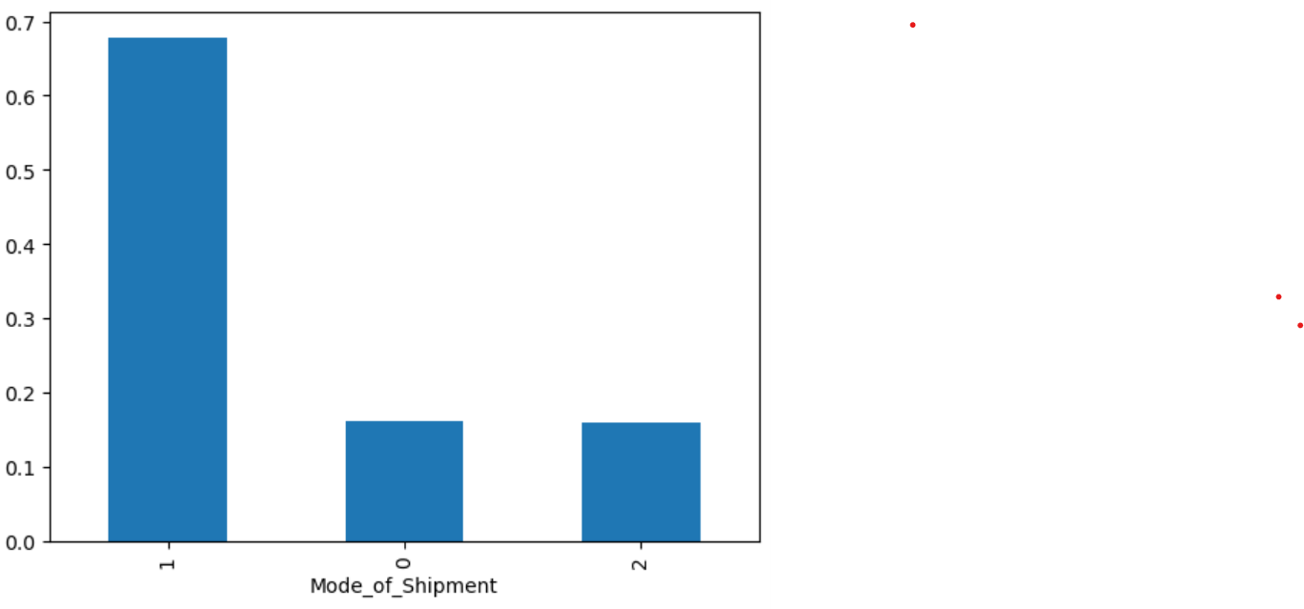
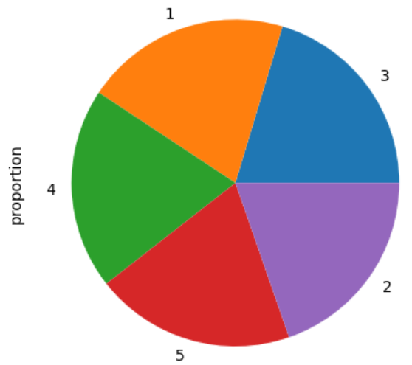
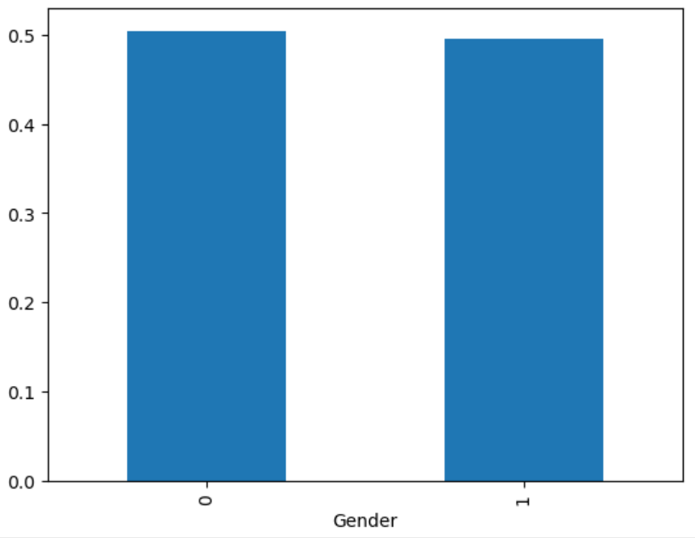
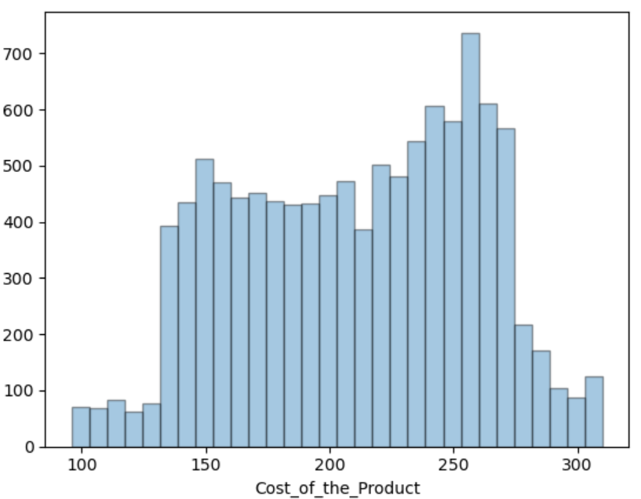
Exploratory Data Analysis(EDA)
It is an analysis approach that identifies general patterns in the data.
Bar Graph of Model Shipment: This graph shows from which mode of transport deliveries are done the most 0 represents Flight,1represents Ship and 2 represents Road so its evident here that most of shipments are transported by Ship.
Pie Chart: This pie chart depicts the ratings of the products and delivery services by the customers.
Bar Graph of Gender: The bar graph depicts the gender of customers 0 represents Female and 1 represents Male where the number of female customers who order is more than the number of males.
Histogram chart: This chart explains regarding the cost of the products delivered.

Slide 5
Model Building and Evaluation
Model Selection: After EDA started Model evaluation with different Algorithms such as Logistic Regression, K-Nearest Neigbour, Decision Tree and Random Forest.
Training the Model: Used the training data for the algorithms.
Predictions: Used the algorithms to predict future outcomes on the data.
Classification Report : Determined precision, recall,F1 Score
Accuracy: Present overall accuracy of the model.

Slide 6
Conclusion
The overall accuracy of the model was 69%.
Predicted the e-commerce delivery prediction with an accuracy of 69%.
Focussed on predicting the delivery timeliness through these machine learning models so that the company can improve customer experience, and optimize logistics.
Customer ratings are correlated with product delivery timeliness because if the customer gets the product delivered as early as possible the ratings get better benefitting company improving customer experience.

Slide 7
Questions ?

Slide 8
Thank You!

